Slide 1
Group 2:
Fundraising
Sofia Papadopoulou, Elitsa Smilyanova, Cecilia Aglaia Newell, Francesca Lorusso, Jordan Zvezdoski

Slide 2
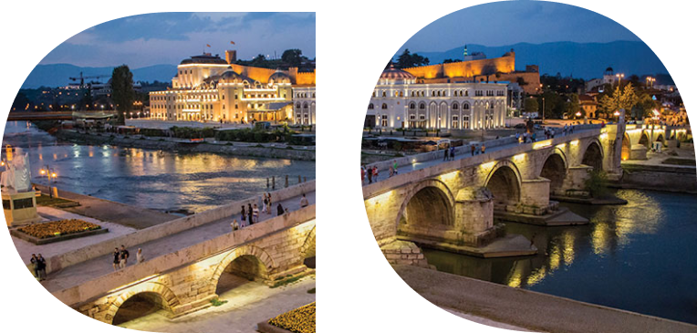
Tasks
Budget Management & Funding rules (challenges, rules, staff)
Financial support programmes for artists (governmental, local, organised by the cultural institution)
Notes:
Elitsa

Slide 3
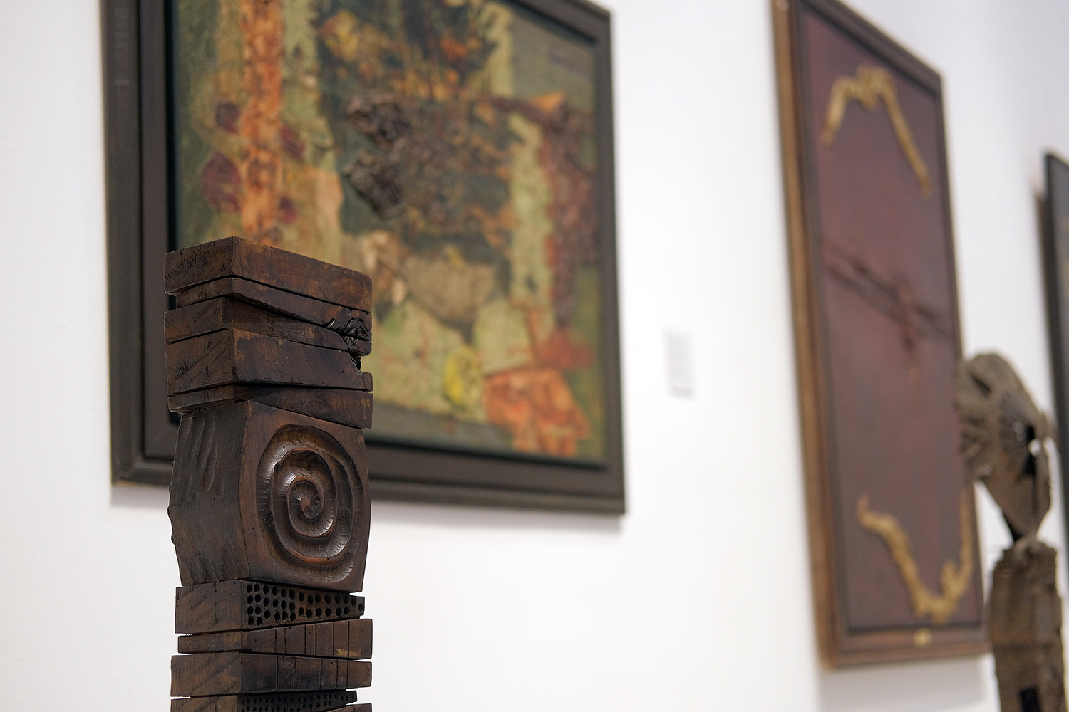
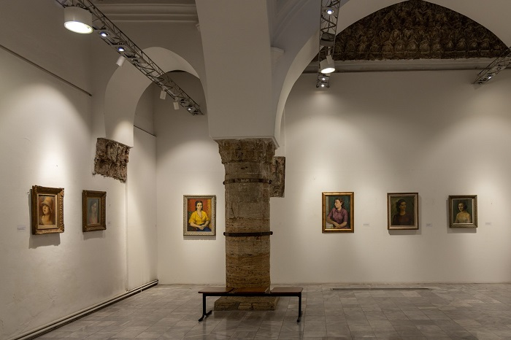
History of National Gallery
;::
Notes:
Jordan

Slide 4
Cultural Heritage
Intangible - Tangible
Notes:
Sofia

Slide 5
Cultural Heritage
Why cultural heritage is important?
Why should we protect our cultural heritage?
National Gallery as a mean of preservation of cultural heritage
Notes:
Sofia

Slide 6
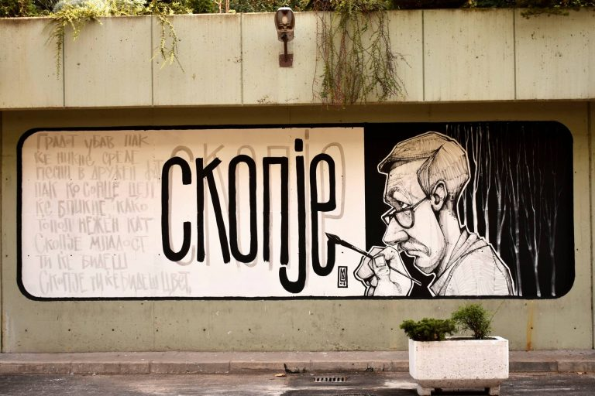
Financial support programmes for artists
Graffiti made by the students of fine arts academy in the city, sponsored by national gallery
Panels of macedonian landscape made by macedonian photographists, sponsored by the National gallery, spread in the city
Introduce on the website of the national gallery videos with interviews of the artists
Skopje art week/day in the city
Asking money to EU/sponsored by private corporations
Promote macedonian artists in the international landscape (attending online exhibitions)
participate in #ArtInMyCity
partecipate in Google Arts & Culture
Notes:
Jordan

Slide 7
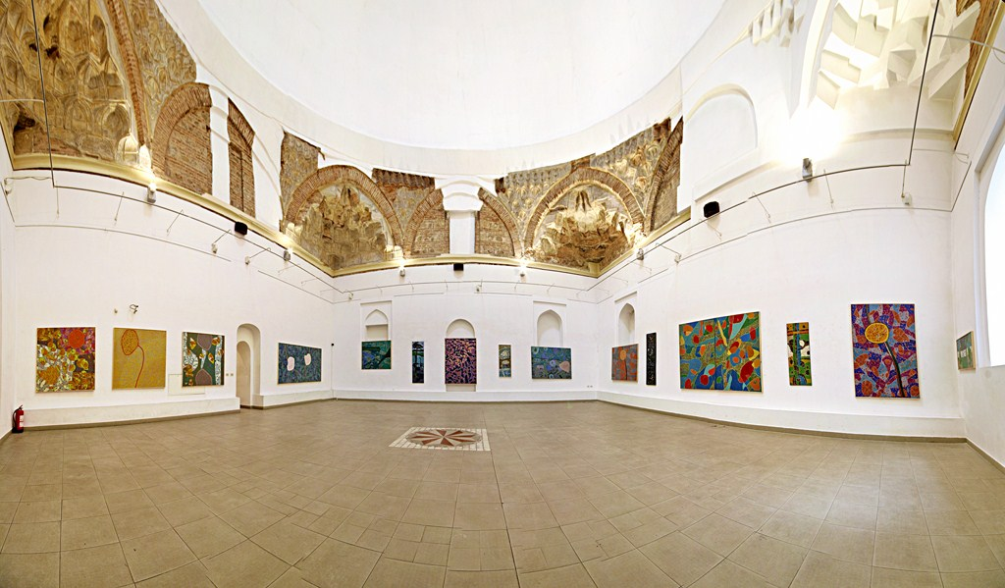
Obtaining finance for artists
Donations through QR code in the city
Crowdfunding with events in National Gallery
Propose Macedonian works (especially the one of contemporary arts) to auction organizations such as Christie’s, Sotheby’s, Phillips, Dorotheum
Subscriptions with different prices related to different targets (families, students, couples) for visiting the buildings with temporary expositions
Notes:
Cecilia

Slide 8
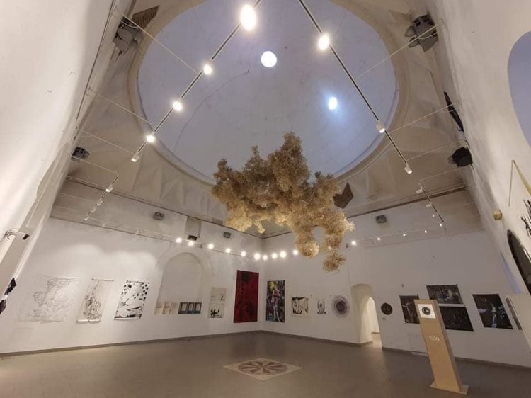
Obtaining finance for artists (continued)
5. Membership programme: Became a member paying an annual subscription that can give free access to museum and to exclusive events
6. Patrons’ program: privileged access behind the scenes tours, especially for curators and museum experts
7. Corporate partnership: hosting private events sponsored (gather money from sponsors)
Notes:
Francesca

Slide 9
How we are going to spend those money?
salary for the workers of the project and the stuff
remodeling of buildings and facilities
support artists and art in general as free lessons of painting, acting teams etc
organize events, new exhibitions
Notes:
Sofia

Slide 10
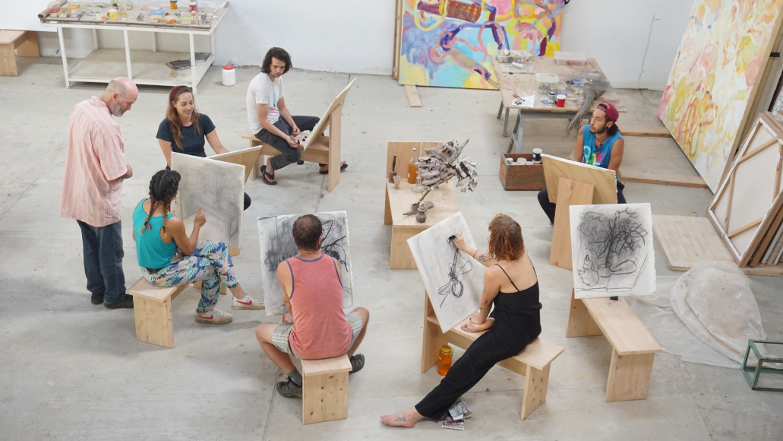
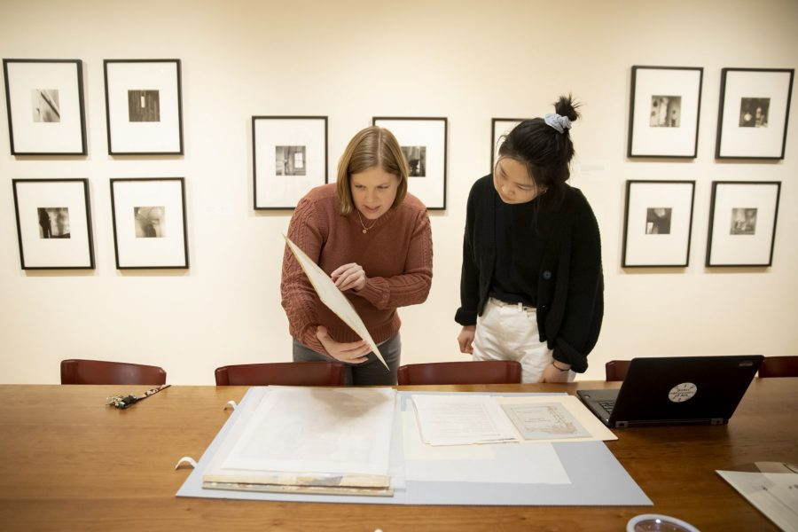
Focus on: Staff innovation
Hire a dedicated Development Officer in charge of partnerships, grants writing and expansion : One responsible person for each separate building+ One Head of Development for the whole National Gallery
Internship programme to gain fresh insights from the youth
International Art Residency programme to collect ideas from artists from all over the world
Notes:
elitsa

Slide 11
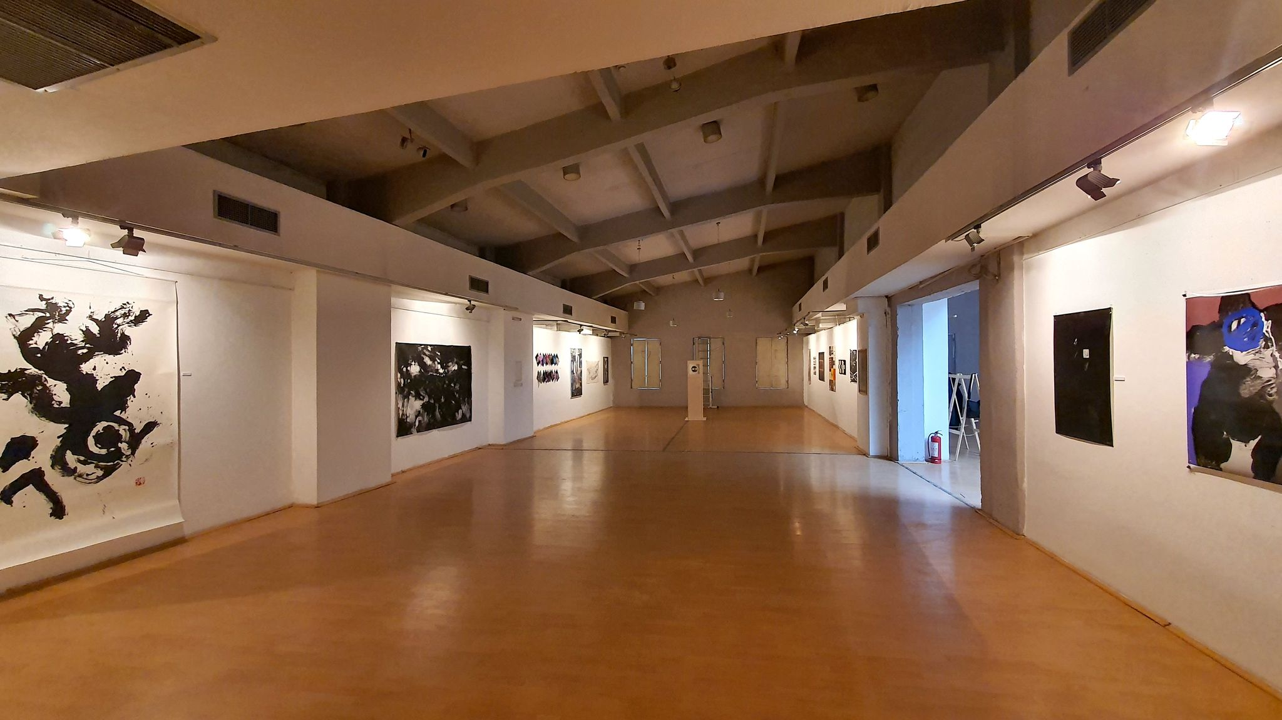
Conclusion
Notes:
elitsa

Slide 12
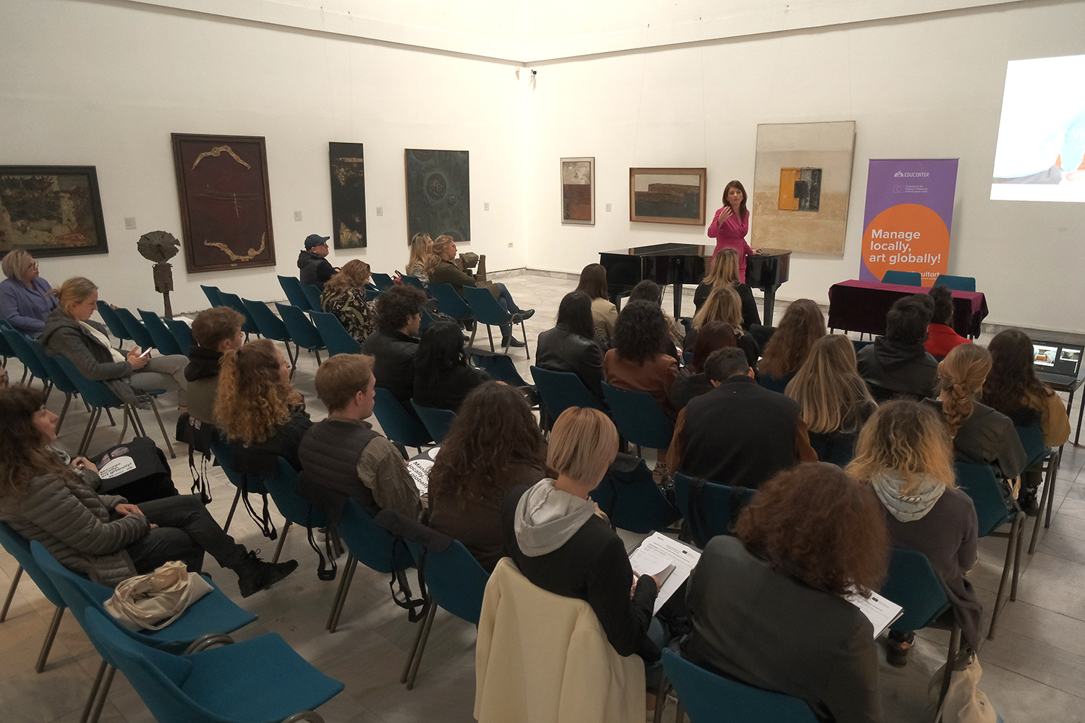
Thank you for your attention!
Notes:
elitsa

