Slide 1
Ioannina LTTA 8 - 12 May 2023

Slide 2
Agenda
Case study
Strategy
Action plan

Slide 3
Strategy 1. Budget impact 2. Promotion & Marketing Ideas 3. 3 months program gap ?

Slide 4
Budget impact Building and technical improvement Tickets and financial support Integrate European arts network Merchandising Donation

Slide 5
Marketing Promoting system -> Rennovation, Social media, YouTube, word of mouth Targeting -> By age, Neighborhood, Interest Advertising -> Poster, Brochure, Flyer

Slide 6
Campain -> set plans Merchandising -> Photo, Stickers, Branding Collaboration -> University, Local business, Bars and restaurant

Slide 7
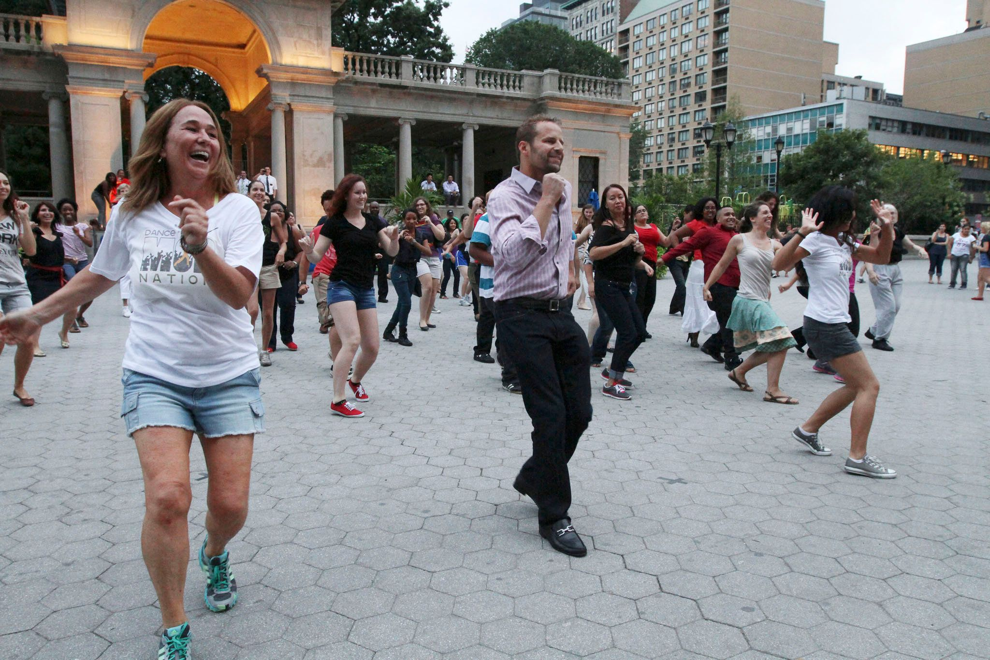
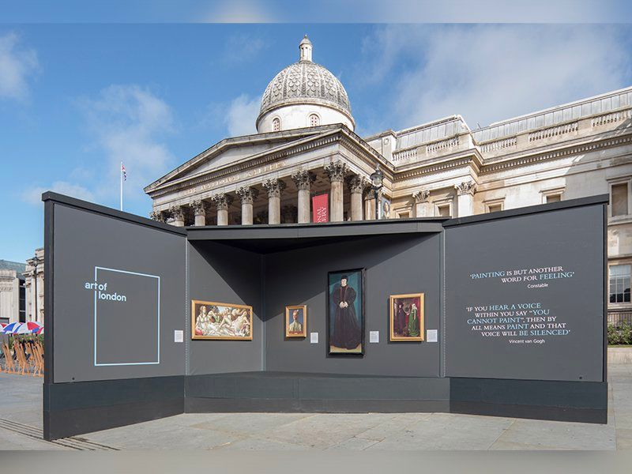
Promotion Exhibition on the street Collaboration with 3Portes and local artists Flash Mob Cooperation with Department of Fine Arts

