Slide 1
Skopje 27 - 31 March 2023

Slide 2
Media, Communication & Brand Identity
Branding and Visual Identity of
the three locations of the National Gallery

Slide 3
Visibility

Slide 4
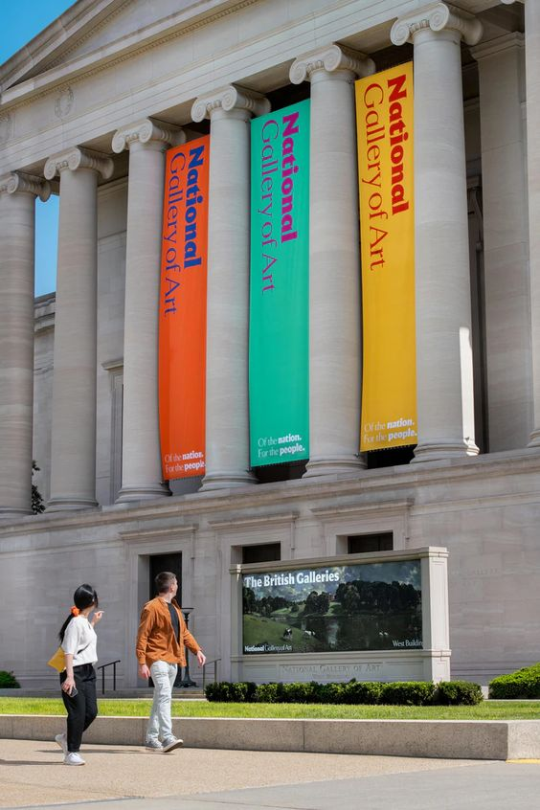
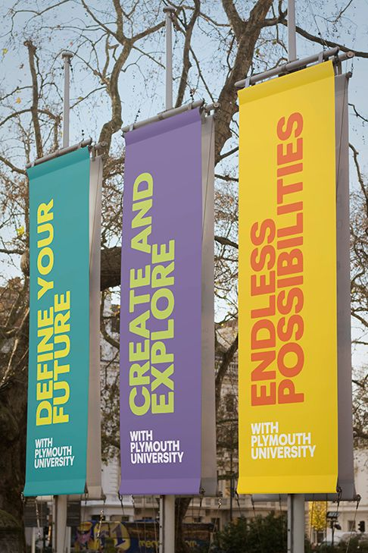
Proposal

Slide 5
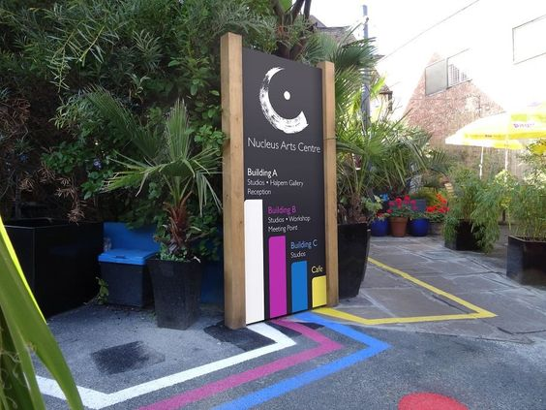
Proposal
The paths to reach the three building in three different colors

Slide 6
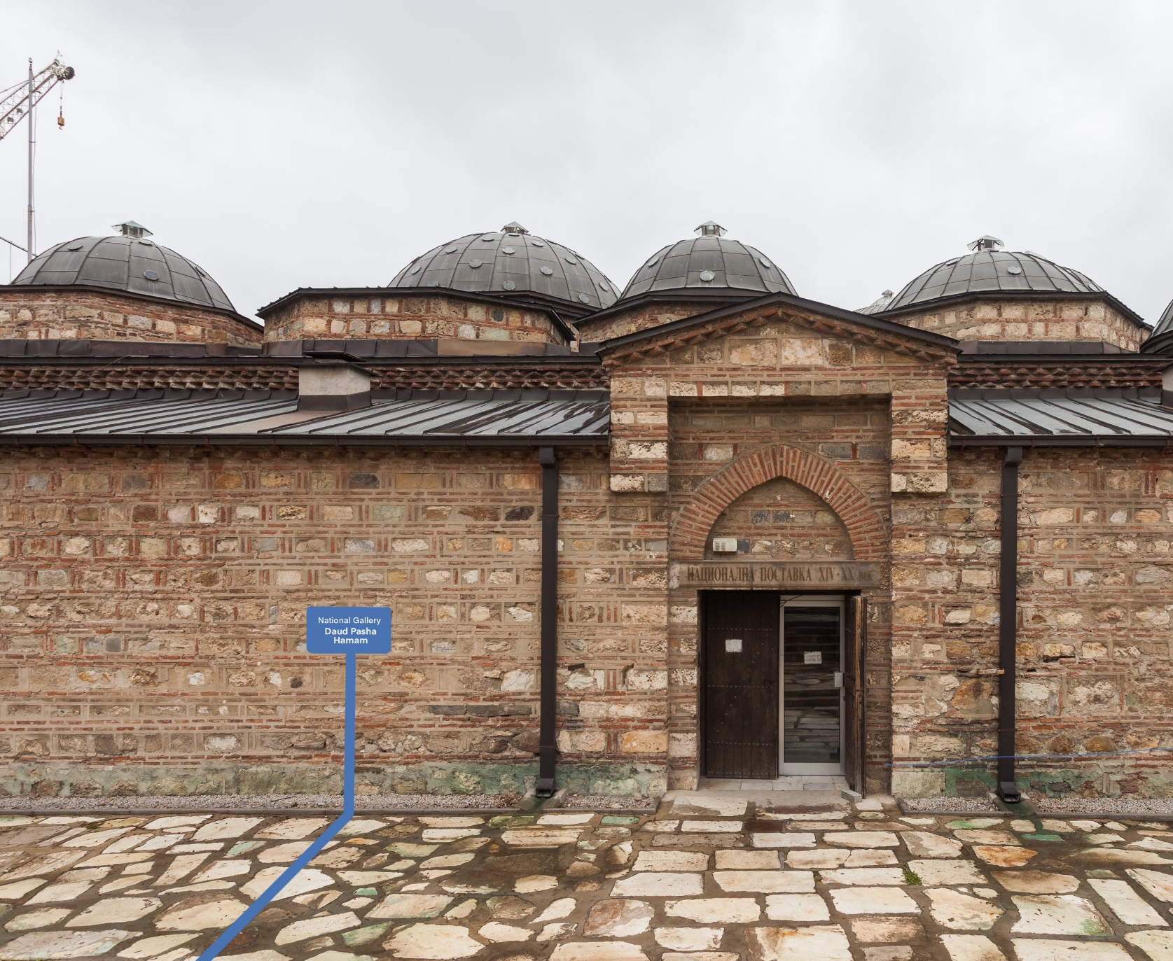
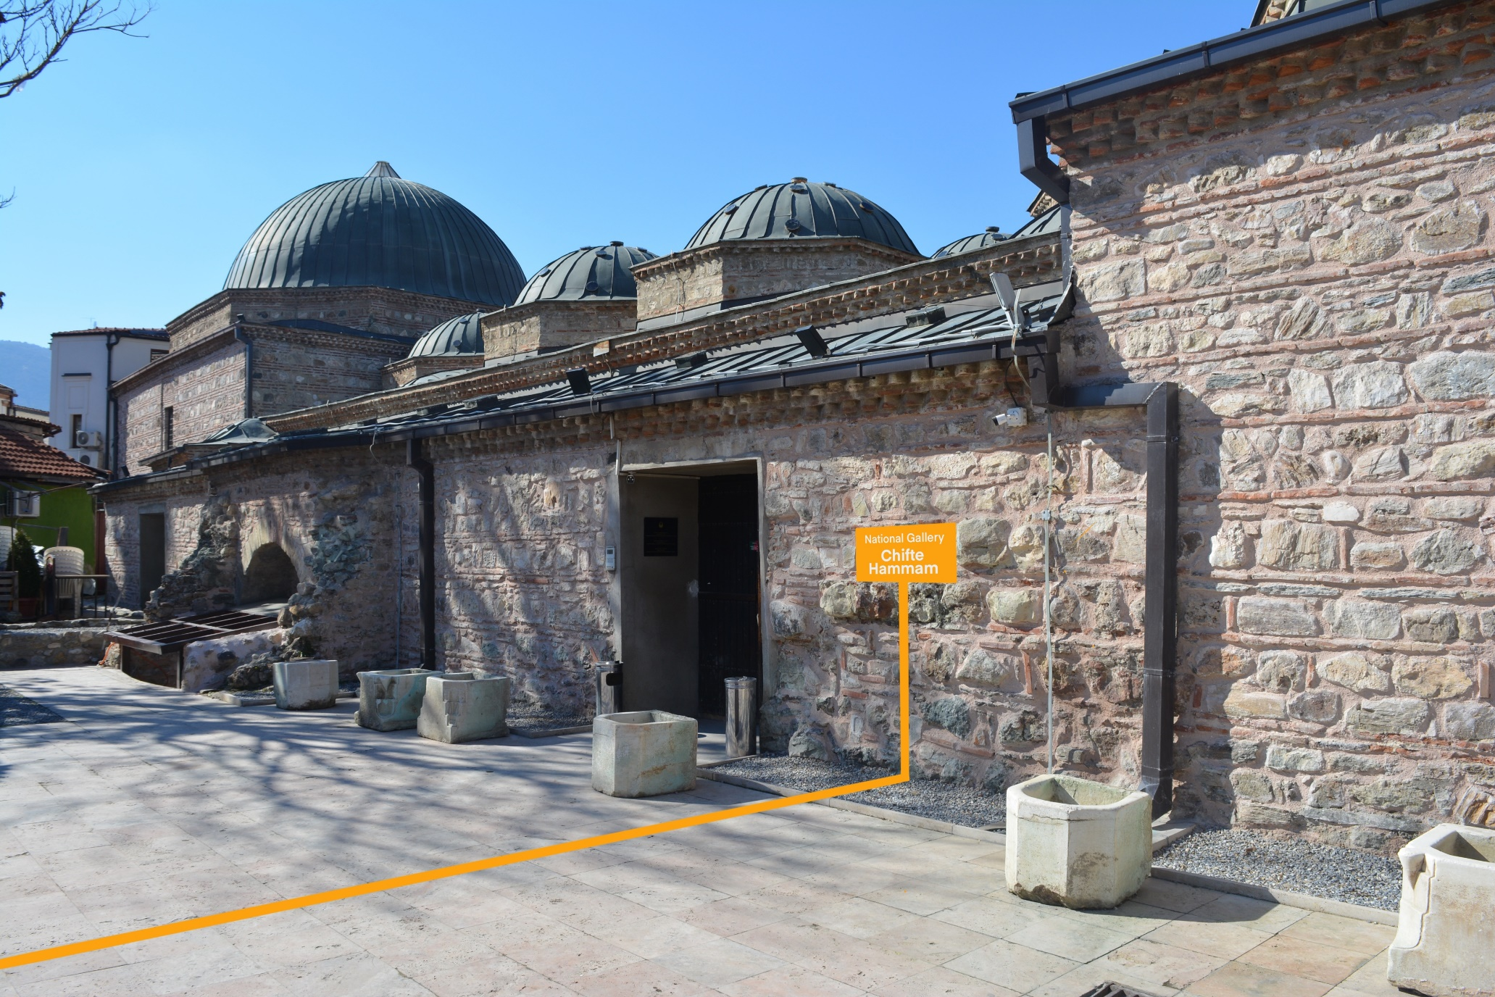
Proposal

Slide 7
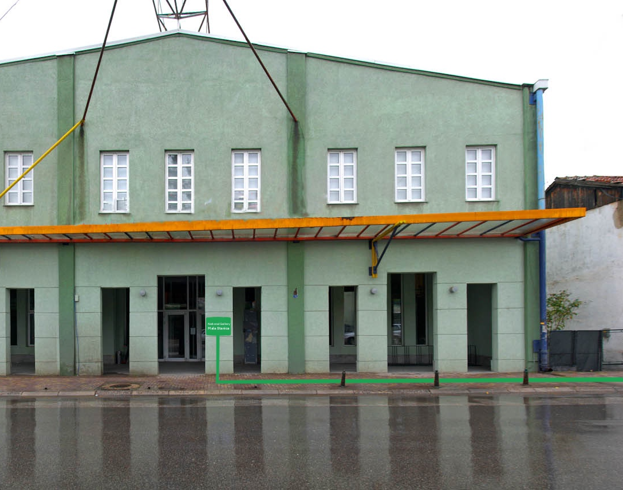
Proposal
National Gallery
Mala Stanica

Slide 8
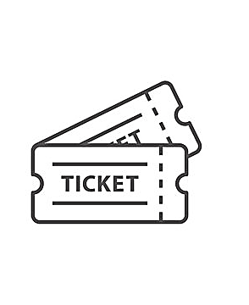
Visual Identity

Slide 9
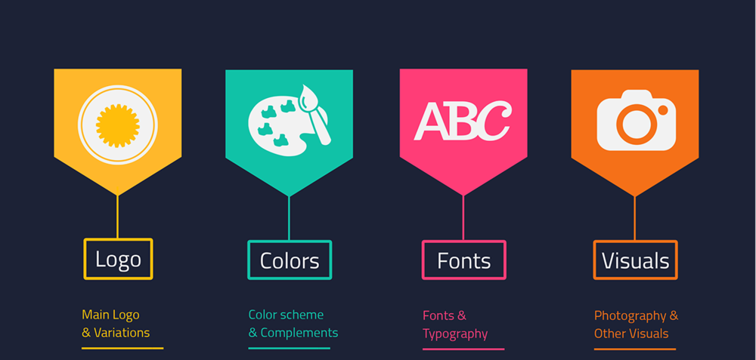
Proposal

Slide 10
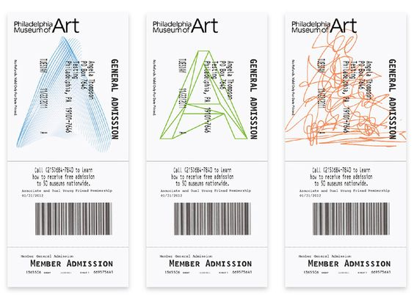
Proposal

Slide 11
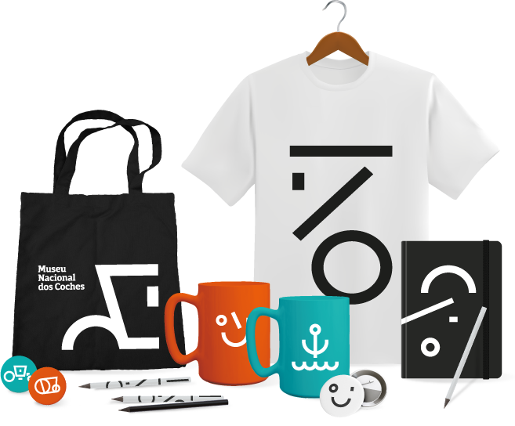
Proposal

Slide 12
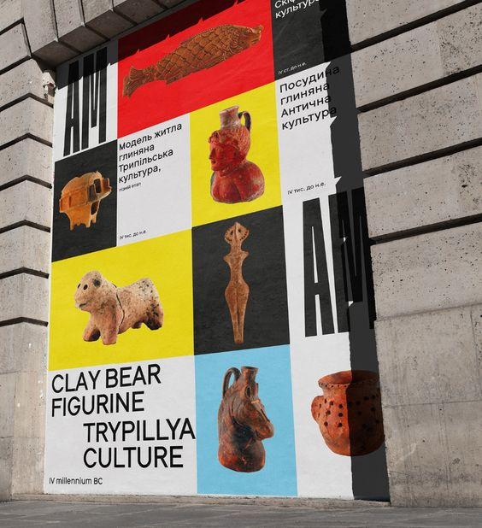
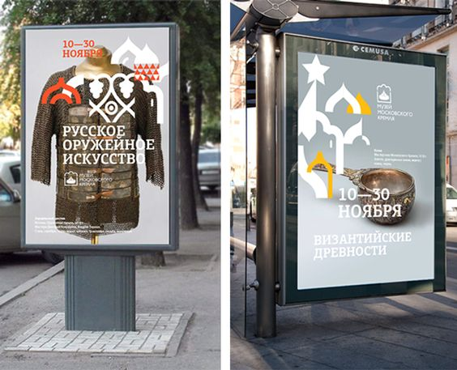
Proposal

Slide 13
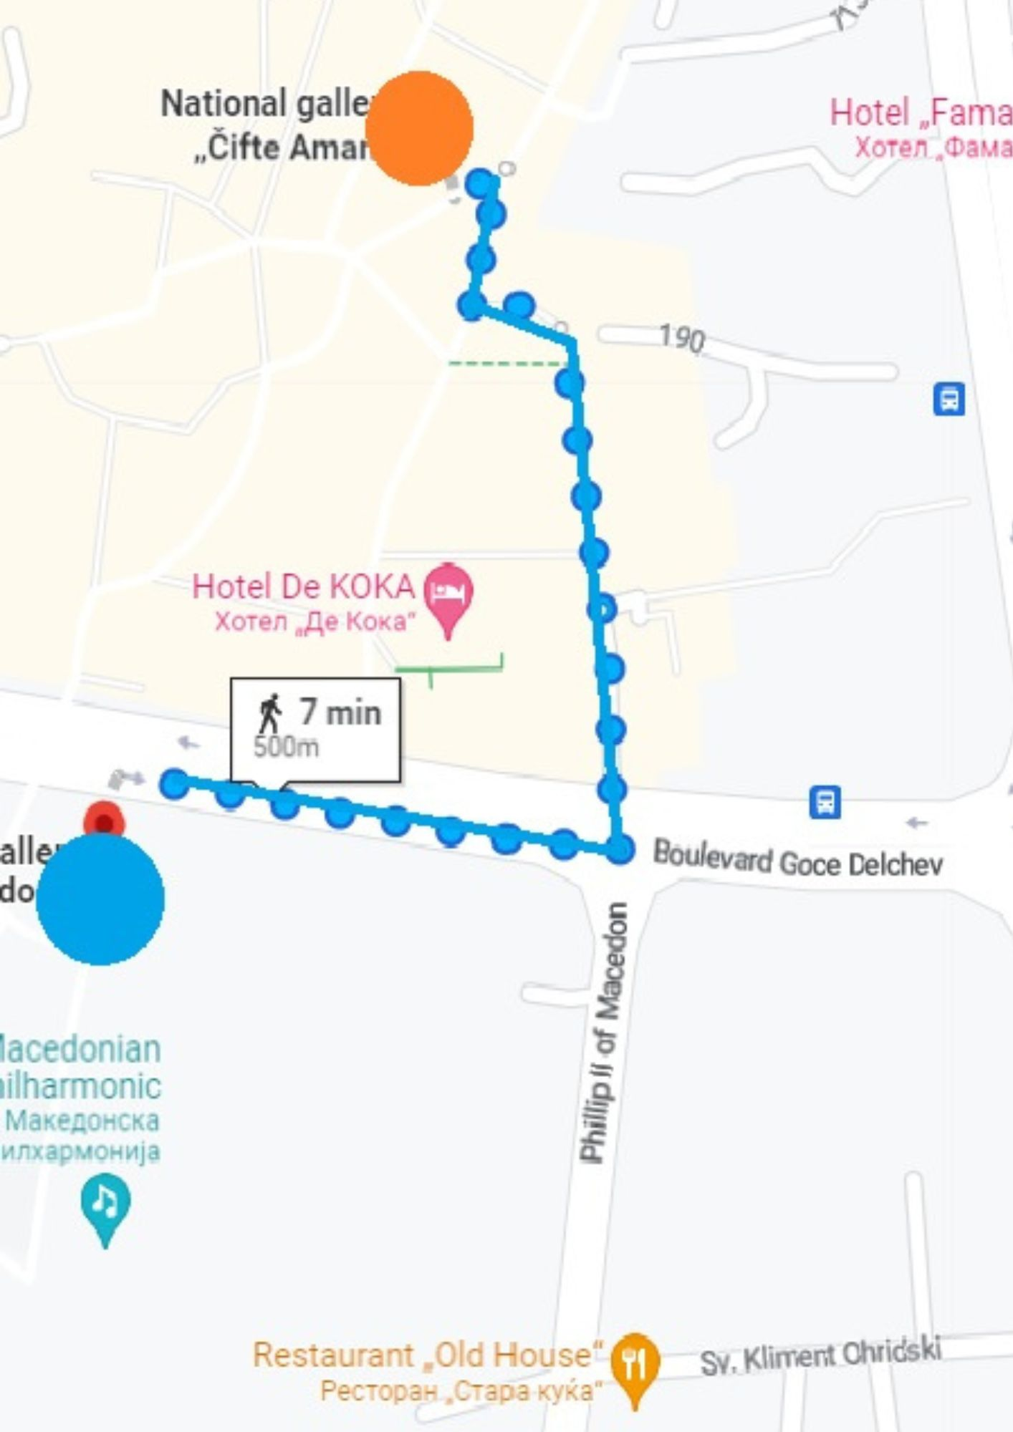
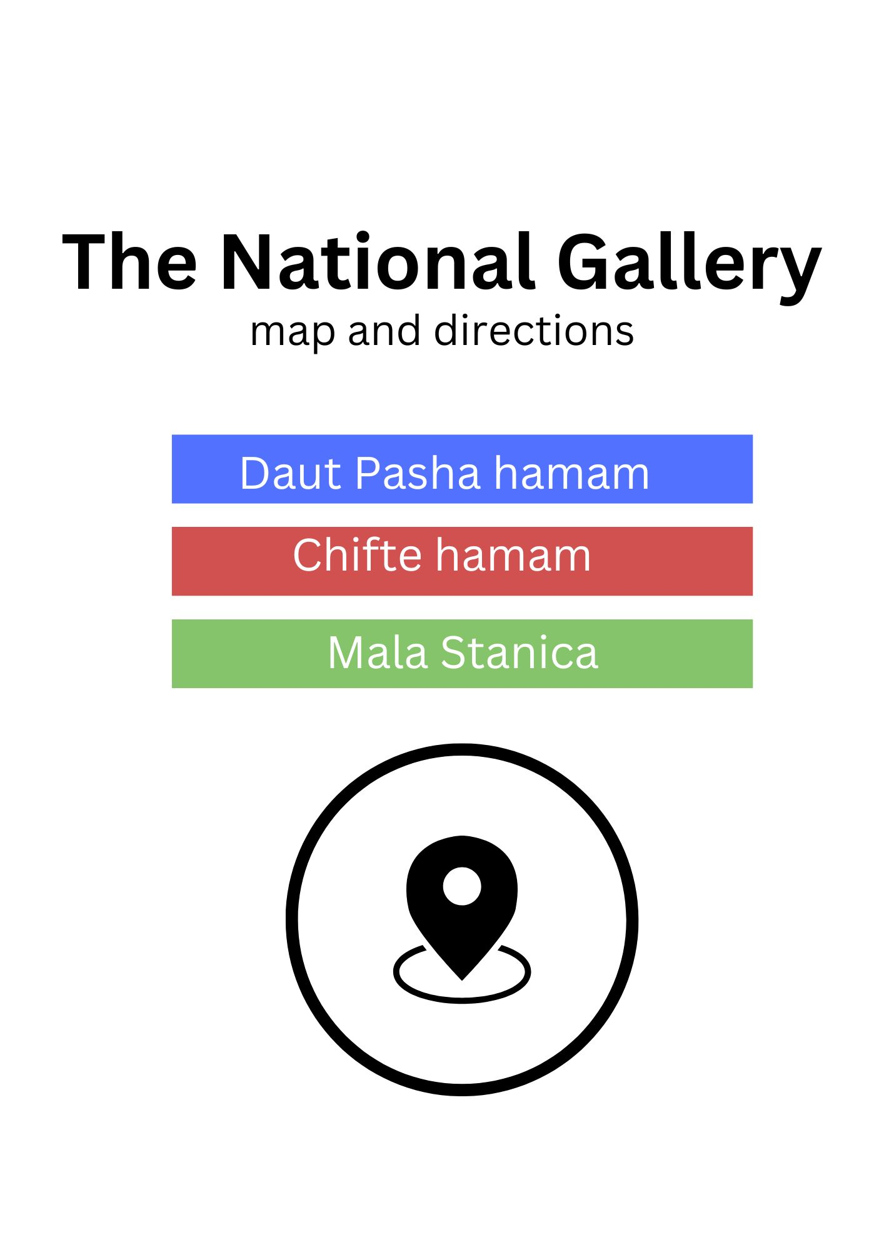
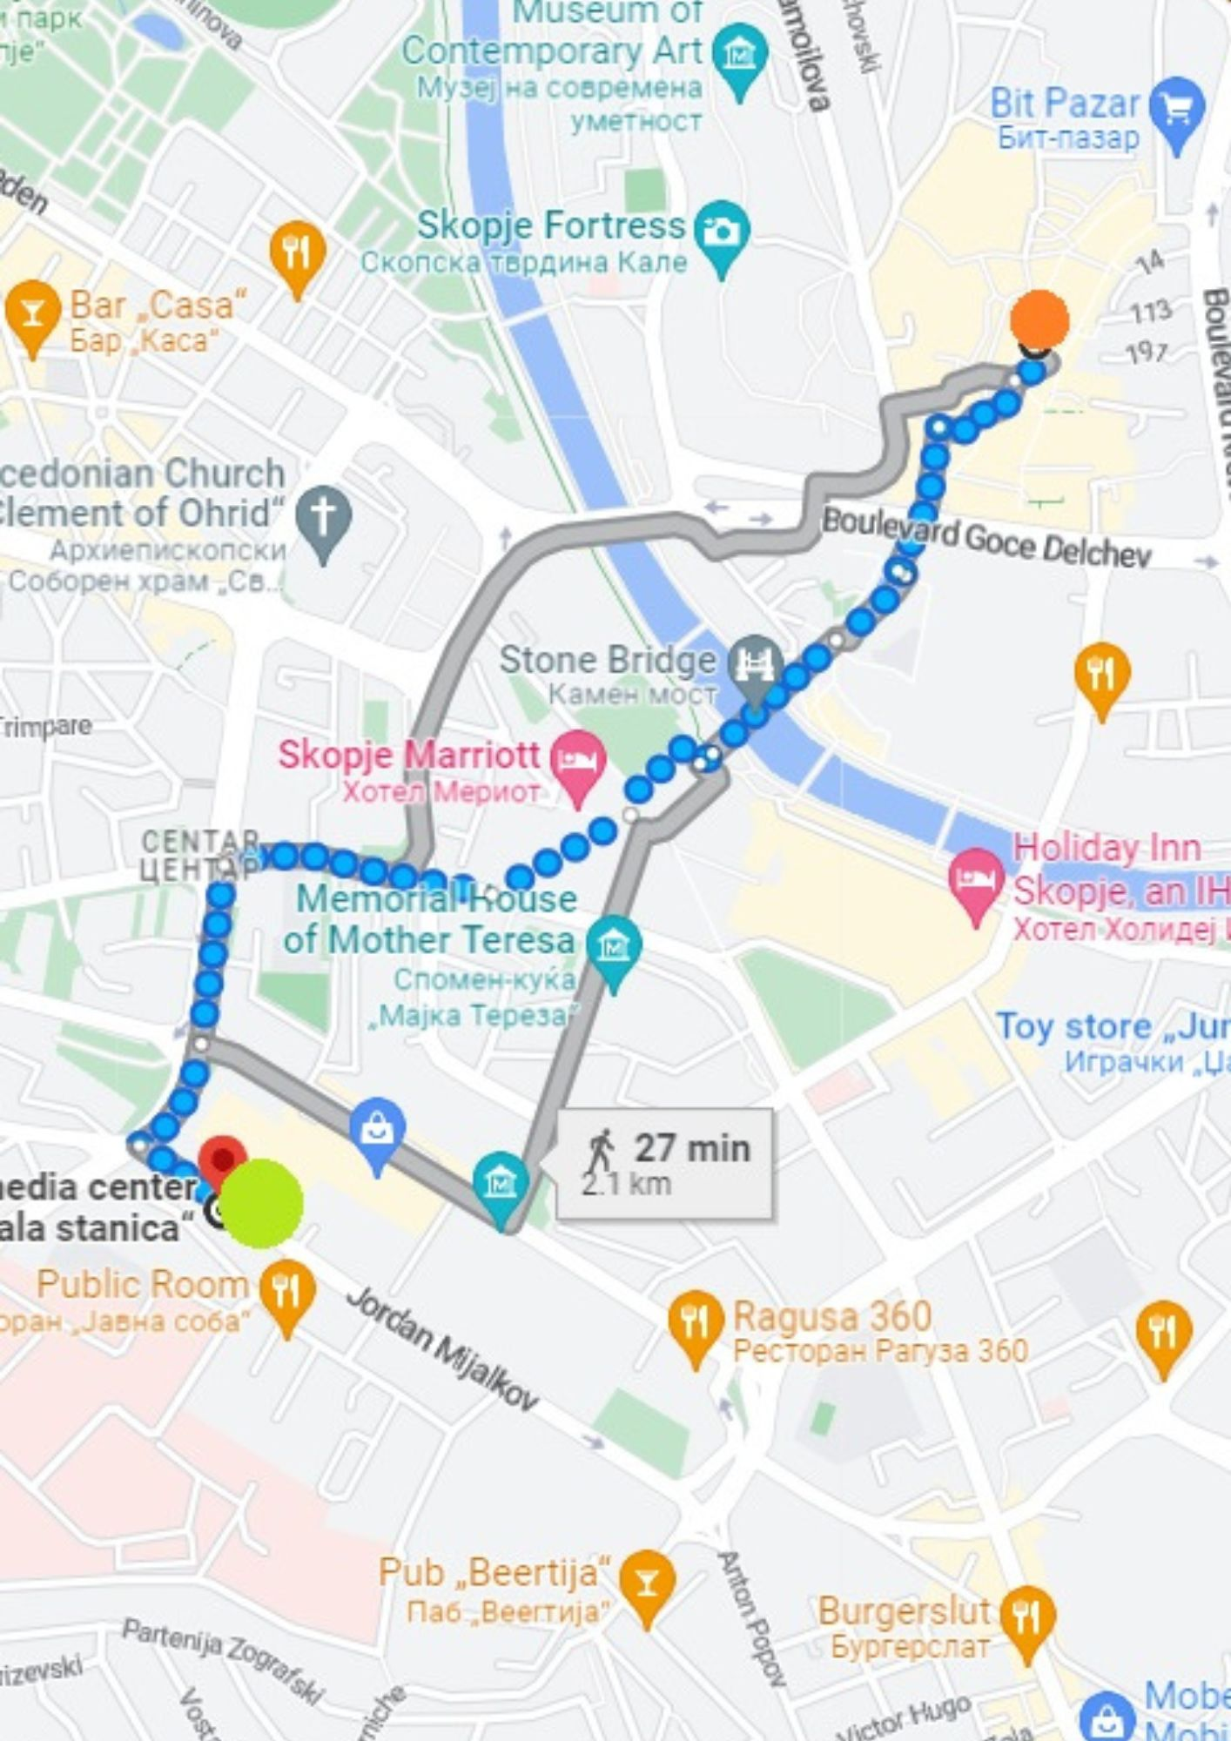
Cohesion between three different locations placement of maps on every location

Slide 14
Strengthen the cohesion – three locations/one exhibition

Slide 15
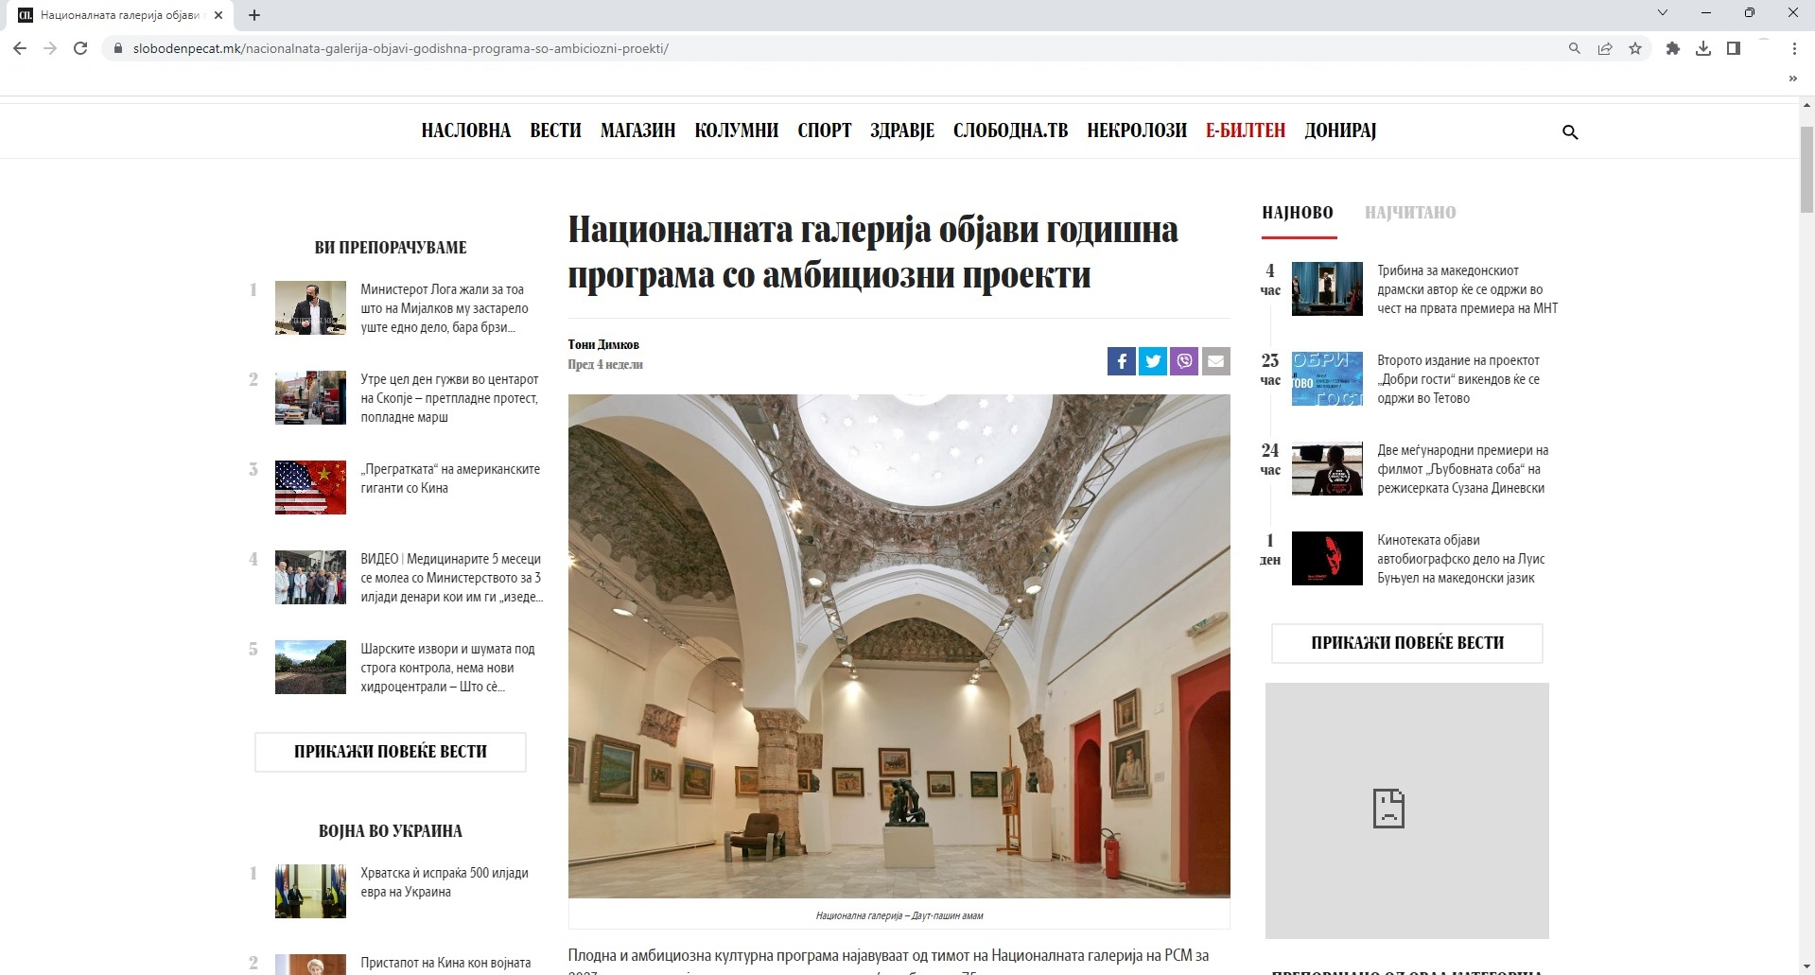
Media presence

Slide 16
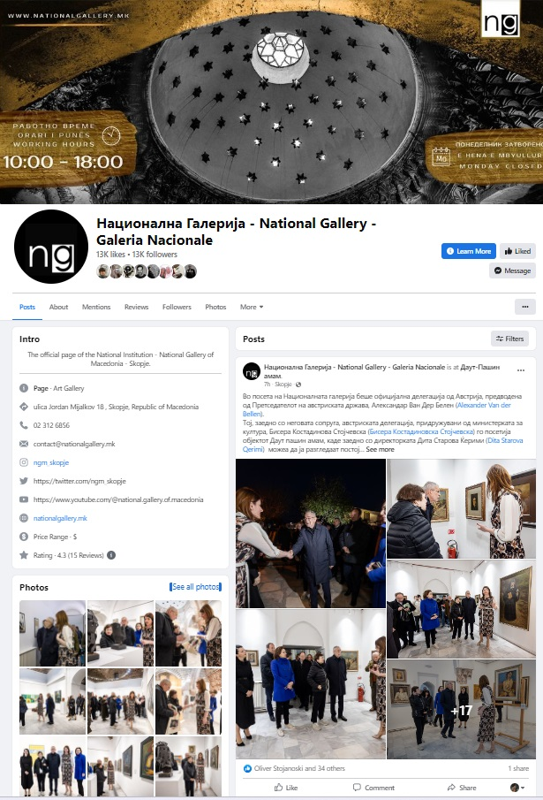
Media presence social media

